Slide 1

Title of the Internship
by
Student Name 1
Roll No. 204G1A32XX
Department of Computer Science and Engineering (Data Science)
Srinivasa Ramanujan Institute of Technology
(Affiliated to JNTUA & Approved by AICTE) (Accredited by NAAC with ‘A’ Grade & Accredited by NBA (EEE, ECE & CSE)
Rotarypuram Village, B K Samudram Mandal, Ananthapuramu – 515701.
2023 - 2024

Slide 2

Contents
Course Objective
Introduction
Technology
Applications
Modules
Real Time applications
Learning outcomes
GitHub Link
Queries

Slide 3
Course Objective
Point 1
Point 2

Slide 4
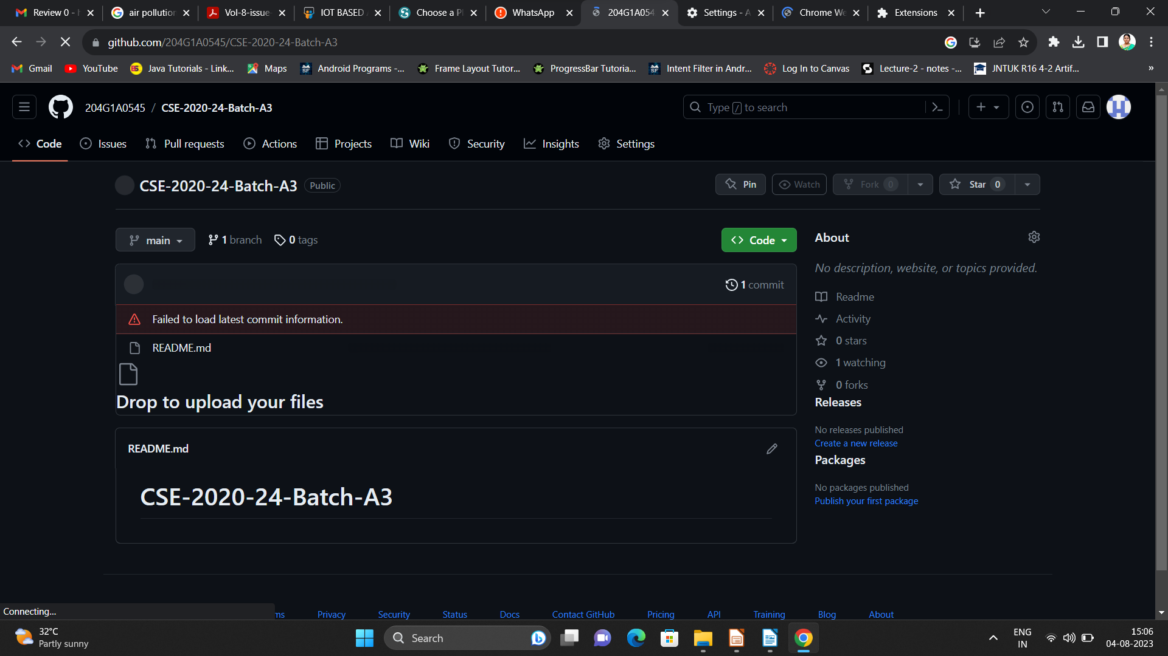

Git Hub Dashboard
Repository Name Like: Summer Internship - I
Under that include document, presentation and Certificate(Pdf).

Slide 5
Any Queries?

Slide 6
Thank You!!!

